Slide 1
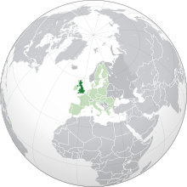
ME Association
ME Research UK
Action for ME
The Young ME Sufferers Trust
reMemberCFS
Blue Ribbon for awareness of ME
Neurological Alliance
ME Trust
25% ME Group
#MEAction
5 steps for a successful co-production

Slide 2
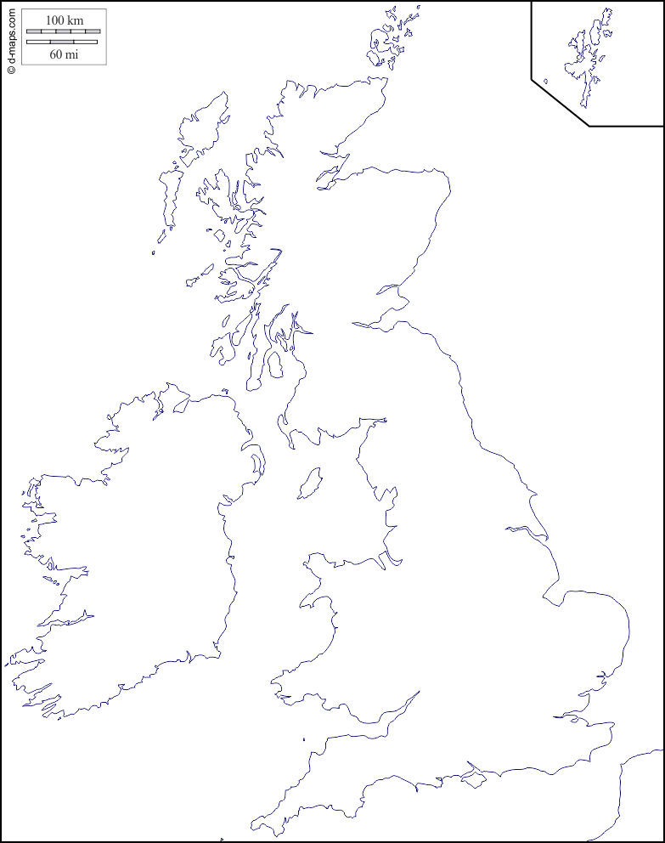
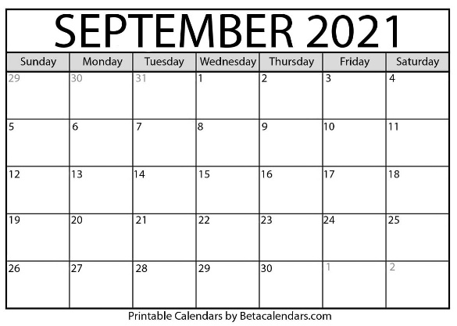
Step 1: Questionnaire from home
Criteria
Professional
diagnosis
16+
Mild
Moderate
Severe
x 20,000
www.decodeme.org.uk

Slide 3
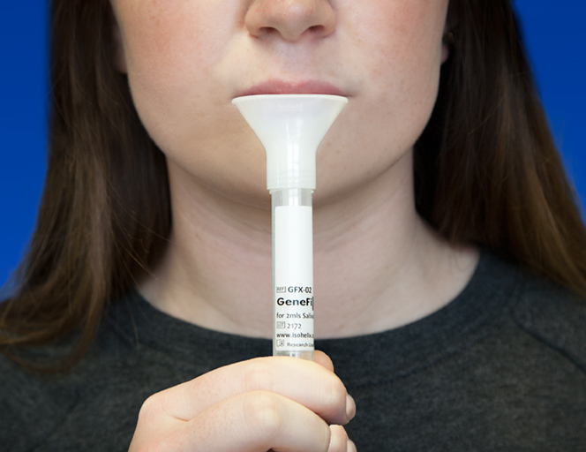
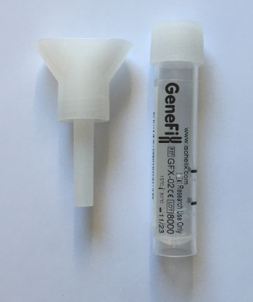
Step 2: Saliva collection from home
www.decodeme.org.uk

Slide 4
Step 3: DNA
www.decodeme.org.uk

Slide 5
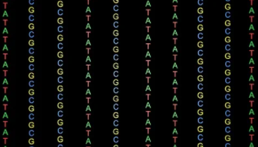
Step 4: Data
www.decodeme.org.uk

Slide 6
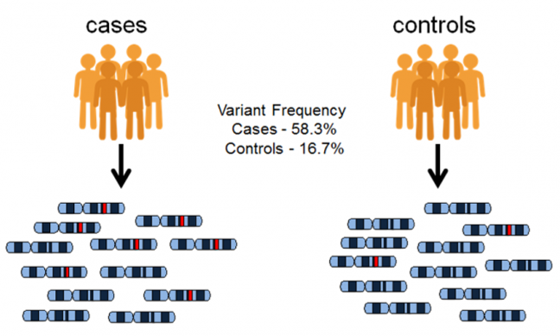
Step 5: DNA data analysis
UK
pwME
UK
G
SNP
500,000
20,000
www.decodeme.org.uk

Slide 7
Step 5: DNA data analysis
Which DNA letters (SNPs) are much more common in cases than controls?
These predict whether someone is a pwME or not.
But SNPs do not perfectly separate pwME from others.
pwME
G
SNP
GWAS – Genome wide association study

Slide 8
Outcomes
Biomedical evidence, catalysing evidence-based experiments.
Overlap (or not) with the genetics of other diseases.
Societal changes in perception of ME/CFS.

Slide 9
What are we doing now?
Ethics

Slide 10
Chris Ponting, on behalf of the DecodeME Partnership
https://www.decodeme.org.uk/

